Slide 2



Symmetric Encryption
Plaintext
Ciphertext
Key 1
Encryption/Decryption
Ciphertext
Plaintext
Key 1
Notes:
.

Slide 3






Symmetric Encryption Considerations
Notes:
.

Slide 4
Symmetric Encryption - Types
Name | Consideration
Advanced Encryption Standard (AES) | Strongest Block cipher 128-bit,192-bit, 256-bit variants
Data Encryption Standard (DES) and 3DES | Weak Block cipher 56 bits(DES) 112 (2 key) 168 bits(3DES)
Blowfish | Block cipher Weak 64 bit
Rivest Cipher (RC*) | RC4 – Stream cipher RC5/RC6 – Block ciphers
Notes:
.

Slide 5

Asymmetric Encryption
Key Pair
Public Key
Key 1
Encrypts
Private Key
Key 2
Decrypts
Notes:
Mathematically aligned
Generated together
Cannot be used with another key from another key pai

Slide 6
Asymmetric Encryption Process
I need to send a secure message!
Public Key
Public key encrypts
Public Key
Private Key
Notes:
.

Slide 7
Asymmetric Encryption Process
I need to send a secure message!
Public key encrypts
Public Key
Private key decrypts
Private key
Notes:
.

Slide 8
Asymmetric Encryption Process
I need to send a secure message!
Public Key
Public key encrypts
Public Key
Private Key
Notes:
.

Slide 9
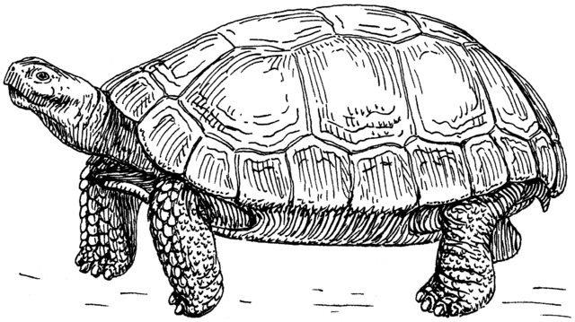

Asymmetric Encryption Considerations
I need to send a secure message!
Public key encrypts
Private key decrypts
Private Key
Notes:
.

Slide 10
Asymmetric Encryption - Types
Name | Consideration
RSA (Rivest, Shamir, Adleman) | One of the oldest
Diffie-Hellman | Old standard Many Variants
Digital Signature Algorithm (DSA) | Endorsed by NIST for their Digital Signature Standard
EIGamal | Used in GNU Privacy Guard, Pretty Good Privacy
Notes:
.

Slide 11

Digital Signatures
Are you who you say you are?
Hash value
Hashing Algorithm
Reveals the hash value
Private Key
Public key decrypts
Notes:
.

Slide 12

Cipher Suite
Agree on a common cipher suite
TLS_DHE_RSA_WITH_AES_256_GCM_SHA384
Transport Layer Security
Mode of Operation
Authentication/Digital Signature Algorithm
Message Authentication Algorithm
Key Exchange Algorithm
Symmetric Encryption Algorithm

